Slide 1
UPPER SIXTH ARTS
GEOGRAPHY
Lesson 11: International Trade
International Trade
Notes:
Good morning, class, and welcome to our geography lesson. I am your geography teacher, Mr Kamdem. Today we are starting Lesson 11: International Trade.

Slide 2
CLASS INFO
Class, Chapter and Duration
Class | Upper Sixth Arts
Chapter | Module 7: Understanding and managing contemporary environmental and development issues
Duration | 2 periods (2 × 50 minutes)
Notes:
This lesson is for Upper Sixth Arts. It belongs to Module 7: Understanding and managing contemporary environmental and development issues. We shall need 2 periods to cover it.

Slide 3
IDENTIFICATION
Lesson Identification
Topic | Current Development Issues
Sub-topic | Trade and Cooperation
Lesson | Lesson 11: International Trade
Notions / Concepts | Trade, export, import, comparative advantage, balance of trade, balance of payments, TRIAD, OPEC.
Syllabus focus | Brief history; comparative advantage; balance of trade and payments; main directions and components; trade links between MEDCs, LEDCs and OPEC; major trade routes (the TRIAD).
Competence | Learners are able to explain international trade and analyse the trade of Cameroon.
Notes:
Our topic is Current Development Issues, and the sub-topic is Trade and Cooperation. The key notions we shall use today are: trade, export, import, comparative advantage, balance of trade, balance of payments, TRIAD, OPEC. At the end, you should be able to do this: learners are able to explain international trade and analyse the trade of Cameroon.

Slide 4

HOMEWORK CORRECTION
Correction of the Homework
Question (Lesson 10: Globalisation):
List ten objects in your home and the country where each was made.
Notes:
Before we start the new lesson, let us correct the homework I gave you at the end of Lesson 10: Globalisation. The question was: List ten objects in your home and the country where each was made. Take out your exercise books.

Slide 5
HOMEWORK CORRECTION
Correction: Possible Answer
Example: phone (China), television (South Korea), rice (Thailand or Vietnam), car (Japan), shoes (China), fabric (Netherlands or China), soap (Cameroon). Most objects come from Asia, showing globalisation.
Notes:
Here is a good answer. Example: phone (China), television (South Korea), rice (Thailand or Vietnam), car (Japan), shoes (China), fabric (Netherlands or China), soap (Cameroon). Most objects come from Asia, showing globalisation. Compare it with your own answer and correct your work in red.

Slide 6
LESSON PLAN
Lesson Plan
Correction of the homework
Objectives and recall
Real-life situation and action to take
Learning activities
Board summary
Evaluation, remediation and homework
Notes:
Here is the plan of our lesson today. First, we shall correct the homework. Then we shall look at the objectives and recall what you already know. After that, we shall study a situation from real life and the action to take, and do the learning activities. Finally, we shall copy the board summary, do the evaluation and the remediation, and I will give you the homework.

Slide 7
OBJECTIVES
Objectives
By the end of this lesson, you should be able to:
Explain comparative advantage.
Distinguish balance of trade and balance of payments.
Notes:
Take your time to copy this part; we will continue together.

Slide 8
OBJECTIVES
Objectives (continued)
Describe the main directions of world trade.
Notes:
By the end of this lesson, you should be able to do three things. Number 1: explain comparative advantage. Number 2: distinguish balance of trade and balance of payments. Number 3: describe the main directions of world trade.

Slide 9
PREVIOUS KNOWLEDGE
Previous Knowledge
Cameroon exports cocoa and oil.
Cameroon imports cars and rice.
Notes:
Let us first remember what you already know. Cameroon exports cocoa and oil. Cameroon imports cars and rice. Keep this in mind, because we shall build on it today.

Slide 10
REAL-LIFE SITUATION
Situation in Real Life
Cameroon sells cocoa, oil and timber but buys rice, cars and medicines. In some years it spends more on imports than it earns from exports.
Notes:
Listen carefully to this situation from real life. Cameroon sells cocoa, oil and timber but buys rice, cars and medicines. In some years it spends more on imports than it earns from exports. Think about it, because I am going to ask you some questions.

Slide 11
REAL-LIFE SITUATION
Situation: Question 1
What is the problem in the situation?
Notes:
Question 1: What is the problem in the situation? Think for a moment, then raise your hand to answer.

Slide 12
REAL-LIFE SITUATION
Answer
Cameroon imports more than it exports.
Notes:
Good. Cameroon imports more than it exports.

Slide 13
REAL-LIFE SITUATION
Situation: Question 2
What is the difference called?
Notes:
Question 2: What is the difference called? Think for a moment, then raise your hand to answer.

Slide 14
REAL-LIFE SITUATION
Answer
The balance of trade (a deficit).
Notes:
Good. The balance of trade (a deficit).

Slide 15
REAL-LIFE SITUATION
Situation: Question 3
Name two exports of Cameroon.
Notes:
Question 3: Name two exports of Cameroon. Think for a moment, then raise your hand to answer.

Slide 16
REAL-LIFE SITUATION
Possible Answer
Cocoa and oil.
Notes:
Good. Cocoa and oil.

Slide 17
ACTION TO TAKE
Action to Take
Buy local products and support processing before export.
Notes:
From this situation, the action we are working towards in this lesson is the following: buy local products and support processing before export.

Slide 18
JUSTIFICATION
Justification of the Lesson
This lesson helps us to understand world trade and Cameroon's place in it.
Notes:
Why is this lesson important for you? This lesson helps us to understand world trade and Cameroon's place in it.

Slide 19
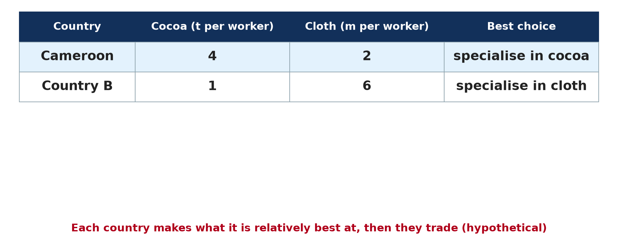
1. COMPARATIVE ADVANTAGE
Activity 1
Comparative advantage (hypothetical).
Notes:
Activity 1. Look carefully at this diagram: comparative advantage (hypothetical). Observe every detail before I ask the question.

Slide 20
1. COMPARATIVE ADVANTAGE
Activity 1: Question
Why should Cameroon specialise in cocoa here?
Notes:
Here is the question for Activity 1: Why should Cameroon specialise in cocoa here? Take one minute to think and write your answer in your rough notebook.

Slide 21
1. COMPARATIVE ADVANTAGE
Activity 1: Answer
It is relatively better at cocoa, so both countries gain by trading.
Notes:
Let us check the answer together. It is relatively better at cocoa, so both countries gain by trading.

Slide 22
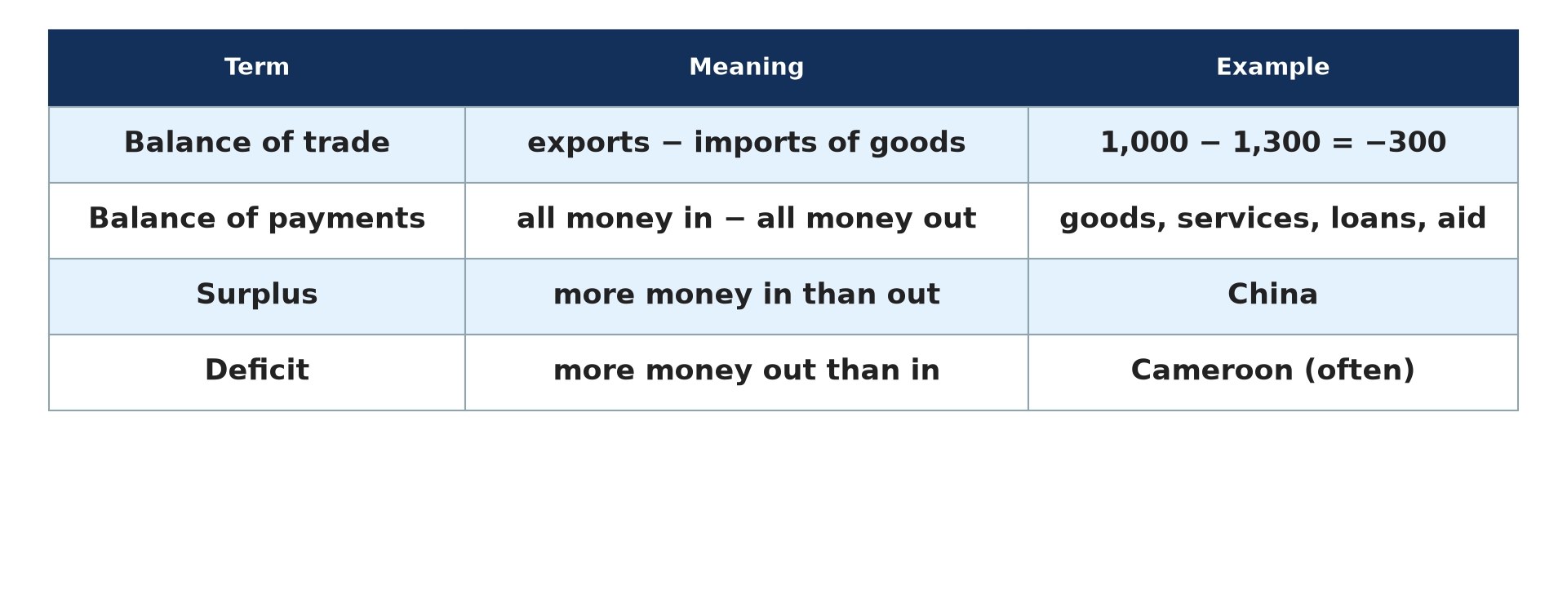
2. BALANCES
Activity 2
Balance of trade and payments.
Notes:
Activity 2. Look carefully at this diagram: balance of trade and payments. Observe every detail before I ask the question.

Slide 23
2. BALANCES
Activity 2: Question
Distinguish balance of trade and balance of payments.
Notes:
Here is the question for Activity 2: Distinguish balance of trade and balance of payments. Take one minute to think and write your answer in your rough notebook.

Slide 24
2. BALANCES
Activity 2: Answer
Trade: exports minus imports of goods. Payments: all money in and out.
Notes:
Let us check the answer together. Trade: exports minus imports of goods. Payments: all money in and out.

Slide 25
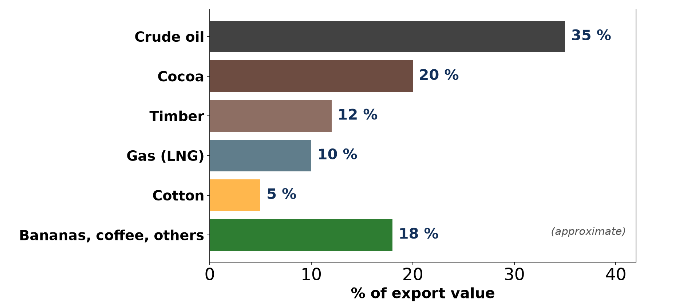
3. COMPONENTS
Activity 3
Exports of Cameroon (approximate).
Notes:
Activity 3. Look carefully at this diagram: exports of Cameroon (approximate). Observe every detail before I ask the question.

Slide 26
3. COMPONENTS
Activity 3: Question
What type of goods does Cameroon mainly export?
Notes:
Here is the question for Activity 3: What type of goods does Cameroon mainly export? Take one minute to think and write your answer in your rough notebook.

Slide 27
3. COMPONENTS
Activity 3: Answer
Raw materials: oil, cocoa and timber.
Notes:
Let us check the answer together. Raw materials: oil, cocoa and timber.

Slide 28
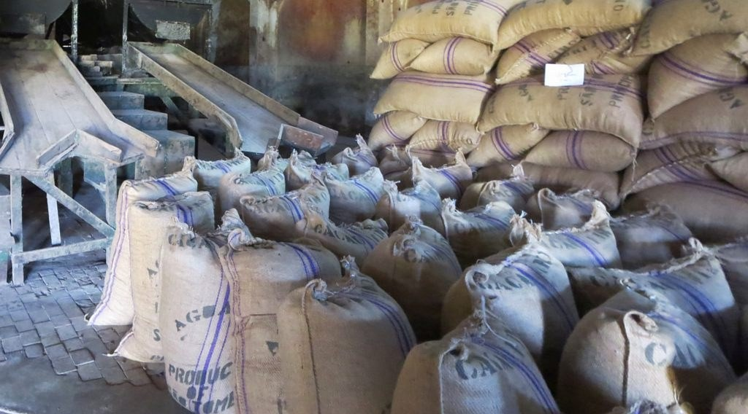
3. COMPONENTS
Activity 4
Sacks of cocoa beans for export.
Notes:
Activity 4. Look carefully at this picture: sacks of cocoa beans for export. Observe every detail before I ask the question.

Slide 29
3. COMPONENTS
Activity 4: Question
Why is exporting raw materials a problem?
Notes:
Here is the question for Activity 4: Why is exporting raw materials a problem? Take one minute to think and write your answer in your rough notebook.

Slide 30
3. COMPONENTS
Activity 4: Answer
Prices are low and change a lot, while manufactured imports are costly.
Notes:
Let us check the answer together. Prices are low and change a lot, while manufactured imports are costly.

Slide 31
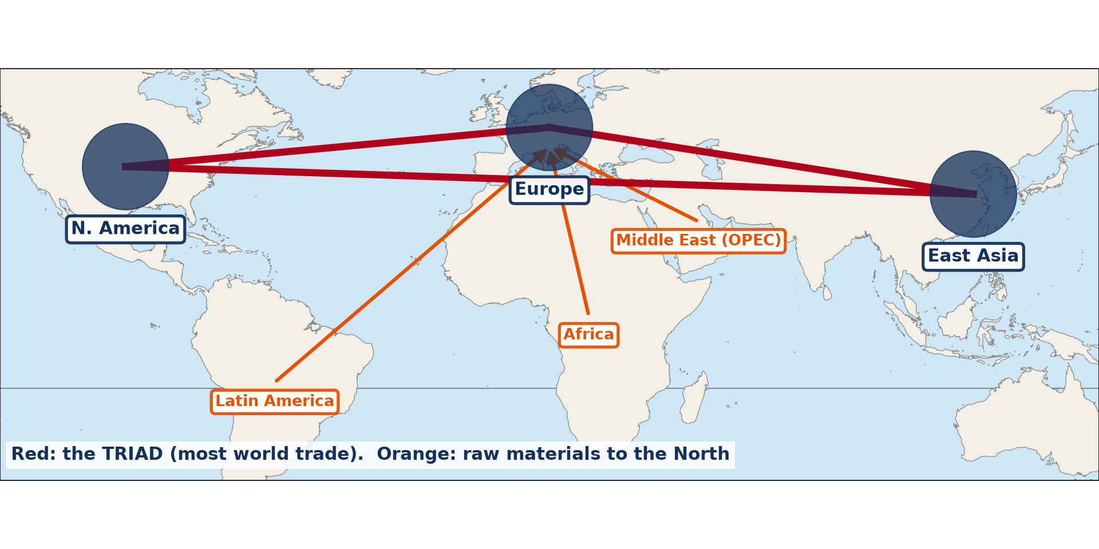
4. DIRECTIONS AND ROUTES
Activity 5
The TRIAD and main flows.
Notes:
Activity 5. Look carefully at this diagram: the TRIAD and main flows. Observe every detail before I ask the question.

Slide 32
4. DIRECTIONS AND ROUTES
Activity 5: Question
What is the TRIAD?
Notes:
Here is the question for Activity 5: What is the TRIAD? Take one minute to think and write your answer in your rough notebook.

Slide 33
4. DIRECTIONS AND ROUTES
Activity 5: Answer
North America, Europe and East Asia, which control most world trade.
Notes:
Let us check the answer together. North America, Europe and East Asia, which control most world trade.

Slide 34
BOARD SUMMARY
Board Summary
Topic: Current Development Issues
Sub-topic: Trade and Cooperation
Lesson 11: International Trade
Notes:
Now we are going to copy the board summary. Write the title and the headings neatly in your notebooks. I will give you enough time for each slide, so do not rush.

Slide 35
BOARD SUMMARY
1. Meaning and Principles of Trade
International trade can be explained as follows:
International trade: It is the exchange of goods and services between countries. Exports are sold abroad and imports are bought from abroad.
Notes:
Let us copy Meaning and Principles of Trade. International trade can be explained as follows. On this slide we have International trade. Write each point on a new line, with the key term first, and explain it in your own words when we revise. When you finish, we go to the next slide.

Slide 36
BOARD SUMMARY
1. Meaning and Principles of Trade (continued)
Brief history: Trade grew from the colonial trade in raw materials to today's world market. GATT (1947) and the WTO (1995) reduced trade barriers.
Notes:
We continue with Meaning and Principles of Trade. On this slide we have Brief history. Write each point on a new line, with the key term first, and explain it in your own words when we revise. When you finish, we go to the next slide.

Slide 37
BOARD SUMMARY
1. Meaning and Principles of Trade (continued)
Comparative advantage: A country gains by specialising in what it produces at the lowest relative cost. It then trades for the other goods it needs.
Notes:
We continue with Meaning and Principles of Trade. On this slide we have Comparative advantage. Write each point on a new line, with the key term first, and explain it in your own words when we revise.

Slide 38
BOARD SUMMARY
1. Meaning and Principles of Trade
Illustration: comparative advantage (hypothetical)
Notes:
Now draw this illustration in your notebook: comparative advantage (hypothetical). Give it a title and label it clearly.

Slide 39
BOARD SUMMARY
2. Balance of Trade and Balance of Payments
A country's trade is measured as follows:
Balance of trade: It is the value of exports of goods minus the value of imports. It is positive (a surplus) when exports are greater.
Notes:
Let us copy Balance of Trade and Balance of Payments. A country's trade is measured as follows. On this slide we have Balance of trade. Write each point on a new line, with the key term first, and explain it in your own words when we revise. When you finish, we go to the next slide.

Slide 40
BOARD SUMMARY
2. Balance of Trade and Balance of Payments (continued)
Balance of payments: It is the record of all money flows with other countries. It includes goods, services, loans, aid and money sent home by migrants.
Notes:
We continue with Balance of Trade and Balance of Payments. On this slide we have Balance of payments. Write each point on a new line, with the key term first, and explain it in your own words when we revise.

Slide 41
BOARD SUMMARY
2. Balance of Trade and Balance of Payments
Illustration: balance of trade and payments
Notes:
Now draw this illustration in your notebook: balance of trade and payments. Give it a title and label it clearly.

Slide 42
BOARD SUMMARY
3. Components and Directions of Trade
World trade has the following components and directions:
Components: LEDCs export raw materials and import manufactured goods. MEDCs export machines, cars and services.
Notes:
Let us copy Components and Directions of Trade. World trade has the following components and directions. On this slide we have Components. Write each point on a new line, with the key term first, and explain it in your own words when we revise. When you finish, we go to the next slide.

Slide 43
BOARD SUMMARY
3. Components and Directions of Trade (continued)
Links between MEDCs, LEDCs and OPEC: OPEC countries export oil to all regions and import goods and food. LEDCs trade mostly with MEDCs and China, and little among themselves.
Notes:
We continue with Components and Directions of Trade. On this slide we have Links between MEDCs, LEDCs and OPEC. Write each point on a new line, with the key term first, and explain it in your own words when we revise. When you finish, we go to the next slide.

Slide 44
BOARD SUMMARY
3. Components and Directions of Trade (continued)
The TRIAD: North America, Europe and East Asia form the TRIAD and control most world trade. The main routes cross the North Atlantic and the Pacific.
Notes:
We continue with Components and Directions of Trade. On this slide we have The TRIAD. Write each point on a new line, with the key term first, and explain it in your own words when we revise.

Slide 45
BOARD SUMMARY
3. Components and Directions of Trade
Illustration: the TRIAD and main flows
Notes:
Now draw this illustration in your notebook: the TRIAD and main flows. Give it a title and label it clearly.

Slide 46
FORMATIVE EVALUATION
Evaluation 1
Exports 800, imports 1,000. Find the balance of trade.
Notes:
Now let us check what you have understood. Question 1: Exports 800, imports 1,000. Find the balance of trade. Answer in your exercise book.

Slide 47
FORMATIVE EVALUATION
Expected Answer
800 − 1,000 = −200 (a deficit).
Notes:
The expected answer is: 800 − 1,000 = −200 (a deficit). If you got it right, well done.

Slide 48
FORMATIVE EVALUATION
Evaluation 2
Name the three parts of the TRIAD.
Notes:
Now let us check what you have understood. Question 2: Name the three parts of the TRIAD. Answer in your exercise book.

Slide 49
FORMATIVE EVALUATION
Expected Answer
North America, Europe and East Asia.
Notes:
The expected answer is: north America, Europe and East Asia. If you got it right, well done.

Slide 50
REMEDIATION
Remediation
Fill in the blanks:
Goods sold abroad are ______.
More imports than exports is a ______.
The oil exporters' group is ______.
Notes:
For those who need more practice, fill in the blanks in your exercise book. The answers are: number 1, exports; number 2, deficit; number 3, OPEC.

Slide 51
HOMEWORK
Homework
Find the main trading partners of Cameroon and draw a flow map.
Notes:
For your homework: Find the main trading partners of Cameroon and draw a flow map. We shall correct it at the beginning of our next lesson.

Slide 52
NEXT LESSON
Next Lesson
Our next lesson will be on:
Lesson 12: Trade Associations (Trade Blocs)
Notes:
Our next lesson will be on Lesson 12: Trade Associations (Trade Blocs). Thank you for your attention, and see you next time.

Slide 53
BILINGUAL GAME
Bilingual Game (Jeu Bilingue)
English | Français
Trade | Le commerce
Export | L'exportation
Import | L'importation
Balance of trade | La balance commerciale
Deficit | Le déficit
Surplus | L'excédent
Notes:
Let us play the bilingual game. I say a word in English, and you give me the French word. Then we do the reverse.

Slide 54
LOGBOOK
Official Logbook (1/2)
Module / Topic | Current Development Issues
Lesson Title | Lesson 11: International Trade
Expected Learning Outcomes | Explain comparative advantage. Distinguish balance of trade and balance of payments. Describe the main directions of world trade.
Competence | Learners are able to explain international trade and analyse the trade of Cameroon.
Notes:
I record this information in the official logbook of the class after the lesson.

Slide 55
LOGBOOK
Official Logbook (2/2)
Matter Taught | Meaning and Principles of Trade; Balance of Trade and Balance of Payments; Components and Directions of Trade.
Evaluation | Formative evaluation and remediation exercise.
Homework | Find the main trading partners of Cameroon and draw a flow map.
Enrolment / Present / Absent | ____ / ____ / ____
Achievement | To be completed after the lesson.
Notes:
I complete the second page of the logbook: the matter taught, the evaluation, the homework and the attendance.

Slide 56
TEACHER'S NOTE
Teacher's Note
Timing: Homework correction, plan, objectives 8 min | Recall, situation, action 10 min | 5 activities 30 min | Board summary (copying) 30 min | Evaluation, remediation 10 min | Homework, next lesson 5 min | Logbook 7 min
Without the projector (Activity 1): compare the figures.
Without the projector (Activity 2): calculate an example.
Without the projector (Activity 3): read the bars.
Without the projector (Activity 4): discuss cocoa prices.
Without the projector (Activity 5): read the map.
Notes:
This slide is for me, the teacher: it gives the timing of the lesson and what to do if the projector is not available.

Slide 57
REFERENCES
References
National Geography Syllabus, MINESEC/IGE/IP-SS, 2019 — Module 7 (Environment and Development).
Photo, Activity 4: “Sacks of Cocoa Beans” by D-Stanley, CC BY 2.0, via Flickr (https://www.flickr.com/photos/79721788@N00/20795057229)
Diagrams and animations: drawn for this lesson (Geography Department).
Notes:
These are the references and picture credits used to prepare this lesson.

